Slide 1
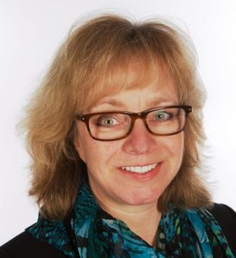
“Bringing sustainability, ethics and investment together - with the help of Fund EcoMarket” CISI members - Wales
Julia Dreblow
BA Hons, Dip PFS
26 January 2017
For information only.
sriServices is not authorised to offer advice.
This presentation is for use by UK financial services professionals only.
Registered company - SRI Consultants Ltd, 03904843

Slide 2
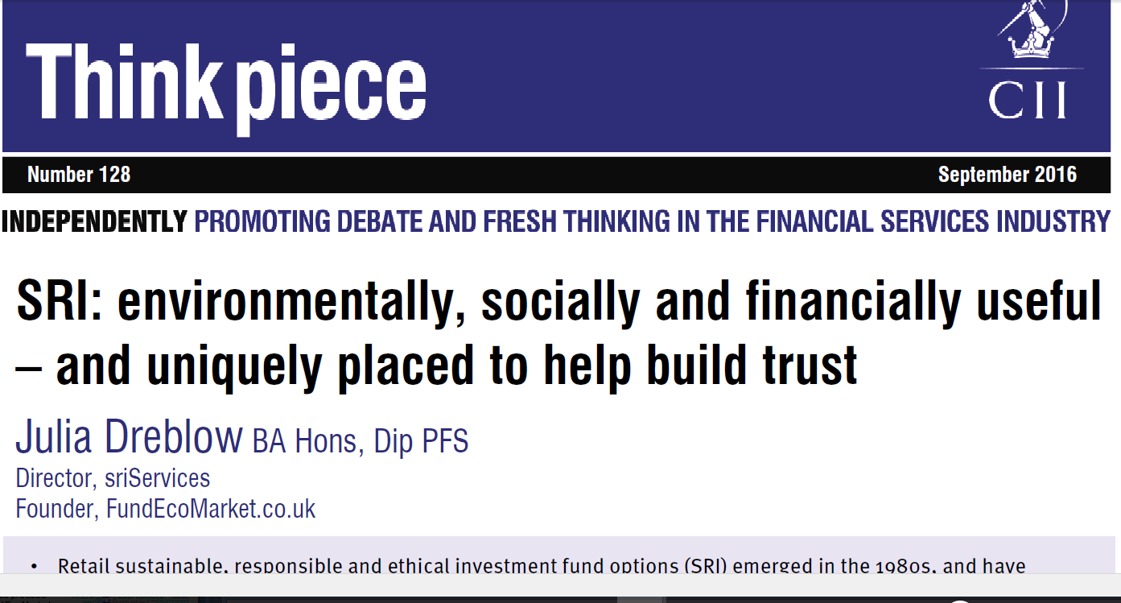
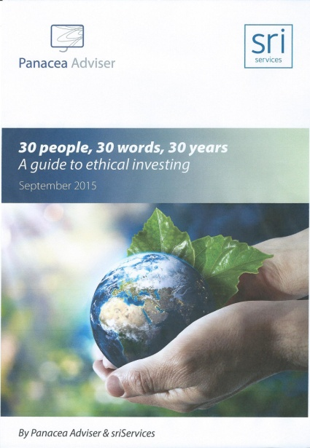
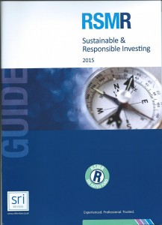
Introduction
Who?
25 years in FS - previously Friends Provident, UKSIF Director/project chair, NPI
‘Highly Commended’ - Corporation of London ‘Sustainable City Awards’ 2015 (SF), finalist 2016. Shortlisted for two Investment Week SRI awards 2016
What?
Online adviser friendly tools & support
sriServices.co.uk
FundEcoMarket.co.uk
Consultancy & partnerships
Why?
Help match clients aims, opinions & lifestyles to investment choices
Grow SRI & direct more investment to better companies

Slide 3
An advice gap
Institutional market size eg UNPRI $60tn
Impact investment – c$35bn 2015 (GIIN)
High profile campaigns gaining ground (eg Divestment)
Markets demonstrate business case eg institutional research ESG risks & opportunities
...
Estimates vary UK retail funds c1-2% of sales (c15bn EIRIS 2015 – highest ever)

Slide 4
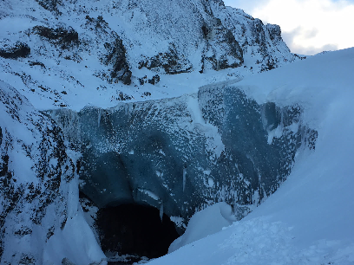
A changing world
Eg.
Law Commission review ‘DC schemes & social investment’
reporting May 2017
Growing interest/concerns, risks & opportunities.
Knock on effect of the ‘political climate’. Hardening opinions? Strengthening resolve?
Stranded assets and related climate risks/opps?
COP 21 and beyond - Investing to keep temperature rise <2°c
Coming soon?: ‘Climate Investment Plans’ – (based on INDCs ‘Intended Nationally Determined Contributions’)
Eyjafjallajökull glacier, Iceland, 12/16,
now 75m higher at base than 3 years ago

Slide 5
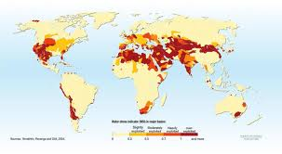
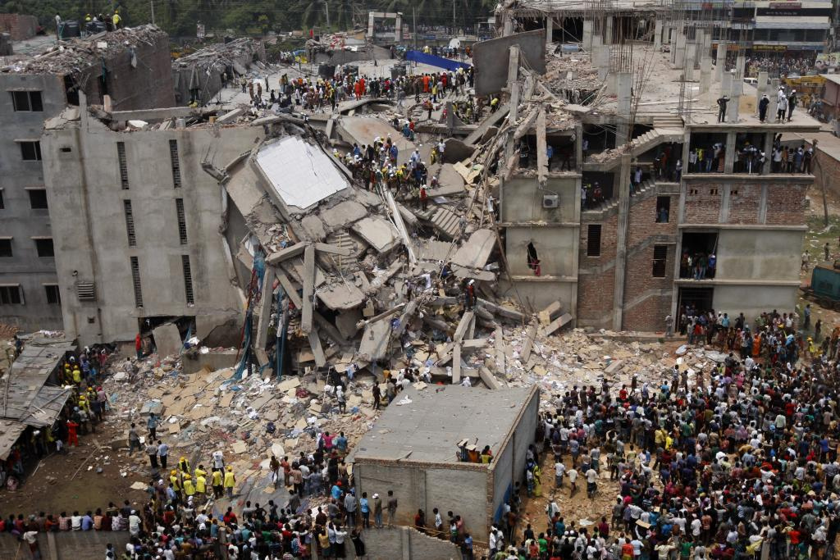
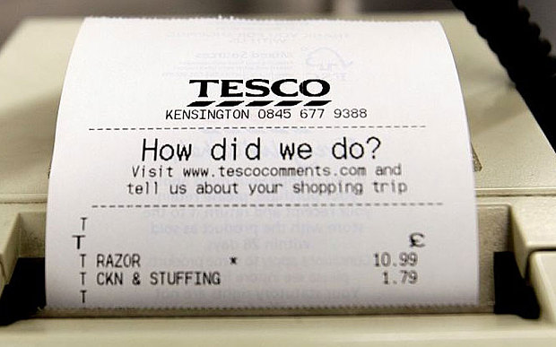
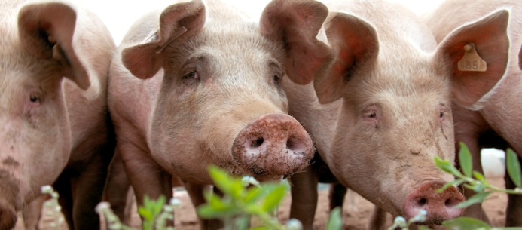
Diverse, dynamic & high profile issues
The diversity of issues makes this area complex to advise on...
Ethical
Social
Environmental
Governance
Tesco accounting issues (UK 2014)
Rana Plaza disaster (Bangladesh 2013)
BP Deepwater Horizon (Gulf of Mexico 2010) . VW governance issues (Germany 2015), Growing water scarcity

Slide 6
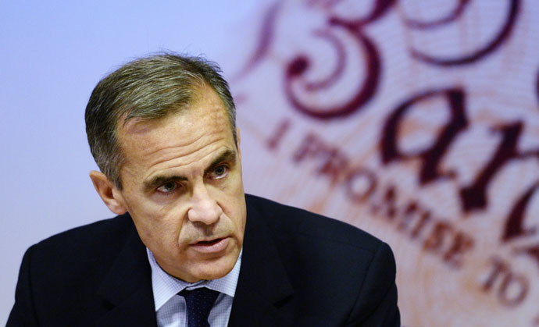
Different approaches
Funds approach issues in different ways...
Support
Avoid
Engage
‘Stranded Assets’ risk & the Bank of England (2015) comments. UN Global Development Goals (2015), Divest ‘go fossil free’ campaign, Tesla

Slide 7
Matching needs to options Plot issues, approaches, aims & financials?

Slide 8
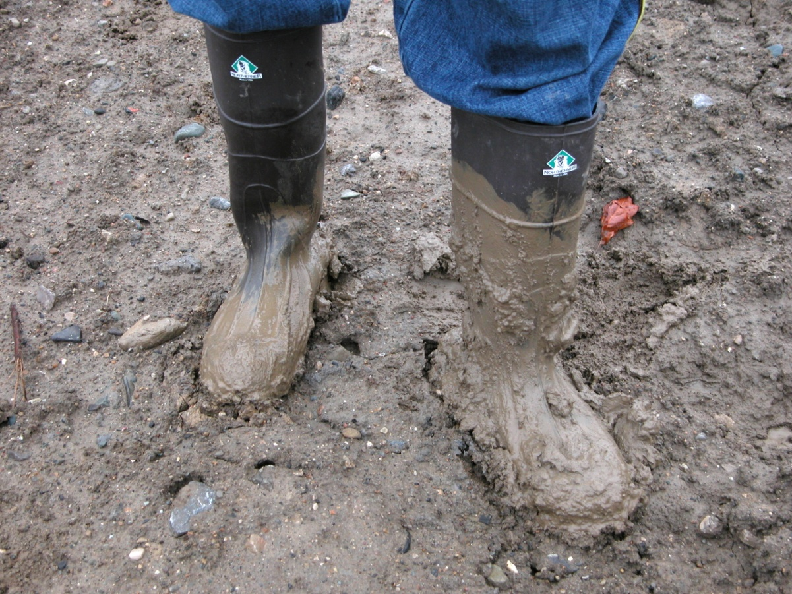
The result?

Slide 9
Made simpler with ‘SRI Styles’ segments:
Highlights diversity, focuses on ‘core commonalities’ – where options are ‘ethically similar’
Simplifies identification of ‘ethically relevant’ fund options (see StyleFinder fact find)
Helps advisers match ‘what a client wants’ to ‘what funds do’
Noting:
Variation within styles
Crossover between styles
Clients may need a ‘deeper dive’
Regulated retail funds and fund managers only
ESG Integration
Sustainability Theme
Ethically Balanced
Negative Ethical
Environmental Theme
Social Theme
Faith Based
Responsible Ownership

Slide 10
‘SRI Styles’ in numbers: Why ‘ethical / not ethical’ fails.
Total: 349 entries
All regulated, retail onshore funds plus additional corporate entries
75 OEICs/UTs
21 ‘Corporate Activity’
‘Styles’ breakdown of all funds opposite
OEIC options include:
UK
22 Global
10 Fixed Interest
12 Mixed Asset
4 Income
Source: Fund EcoMarket October 2016

Slide 11
Fund EcoMarket survey responses
Policies |  | Features |  | Corporate
Avoids Tobacco | 38 | Limited Exclusion policy | 15 | Publish Full Voting Report | 15
Avoids Armaments Manufacture | 40 | Balances Pros & Cons / Best in Sector | 22 | Integrates ESG into all/most fund research | 33
Climate Change / GHG policy | 34 | > 50% Large Cap | 10 | Reviewing carbon/fossil fuel exposure for all funds | 15
Coal, Oil & Gas Majors excluded | 30 | RSMR Rated | 29 | In house voting expertise | 16
Animal Welfare policy | 33 | Faith Friendly | 10 | Responsible ownership / ESG a key differentiator | 16
Social policy | 33 | Positive Selection Bias | 35 | UK Stewardship Code Signatory | 17
Sustainability policy | 46 | Eurosif Transparency | 25 | Vote all shares at AGM’s & EGMs | 12
Measures Positive Impacts | 16 | Norms Focus | 10 | ALL OF THE ABOVE | 0

Slide 12
Example advice process
Identify interested clients
Refine SRI research (if required)
Record your findings
Integrate this into regular processes
eg products, % portfolio, reviews
eg – specific issues, attitudes, other factors
eg - major issues, approaches or SRI styles
Are you interested in ethical, social, environmental or faith related issues?
eg - for reference, compliance & audit trail
Identify key areas of interest

Slide 13
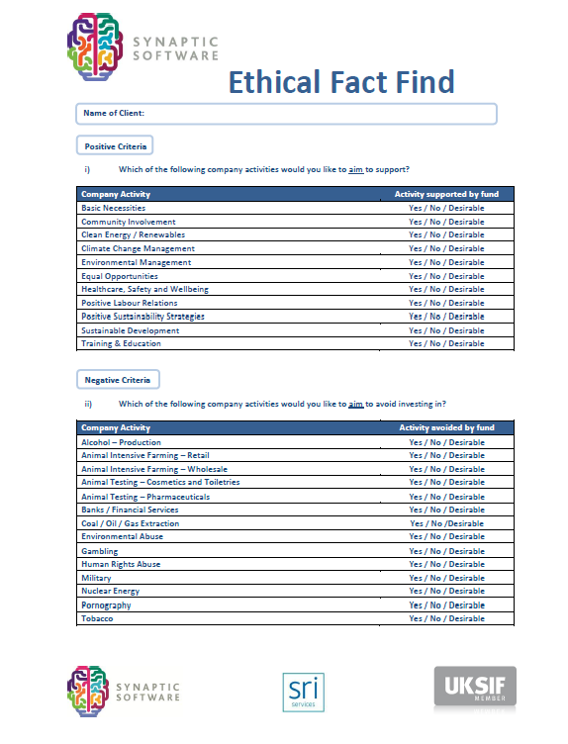
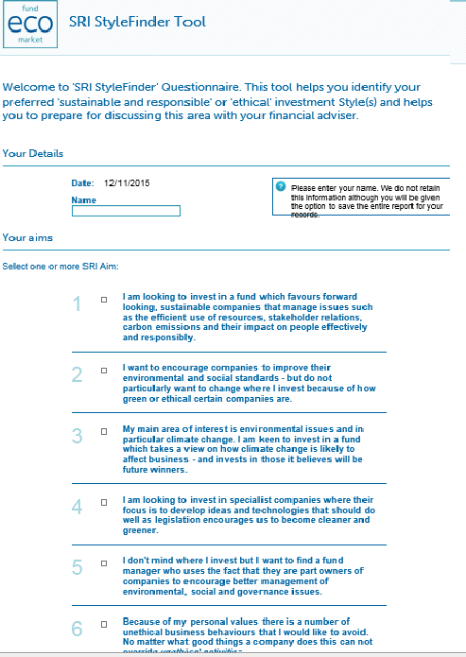
Fact Finding options

Slide 14
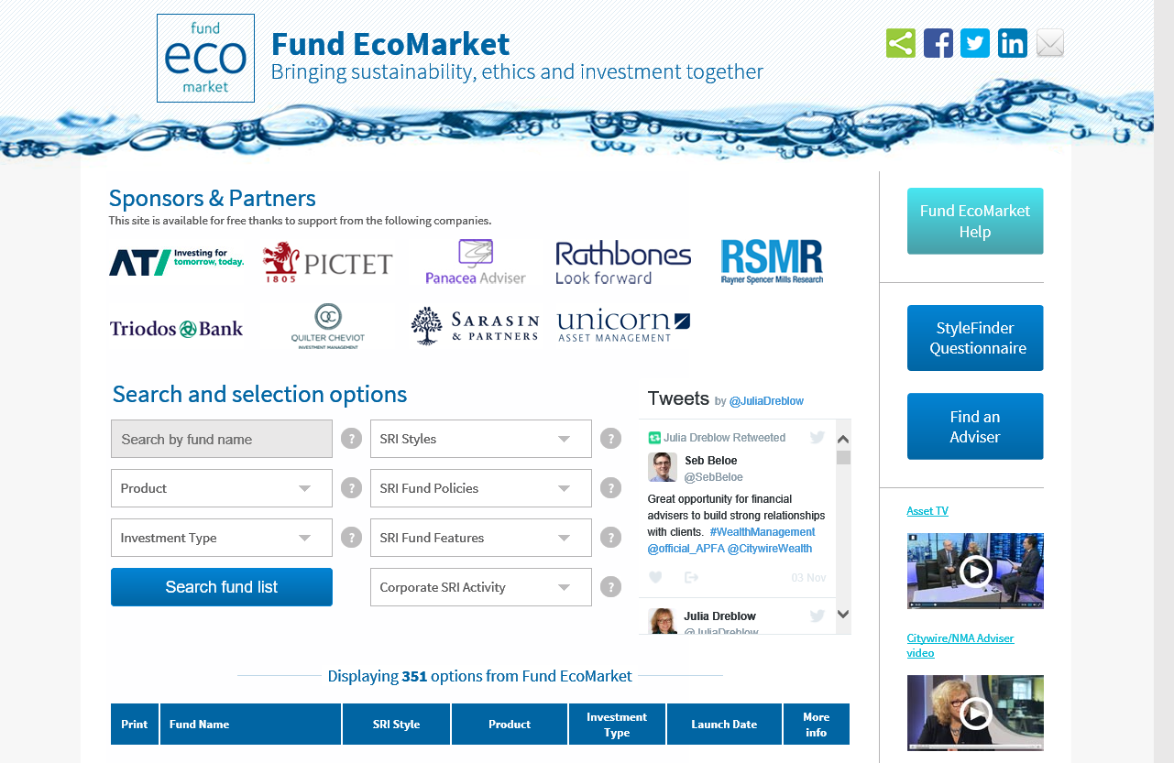
FundEcoMarket.co.uk

Slide 15
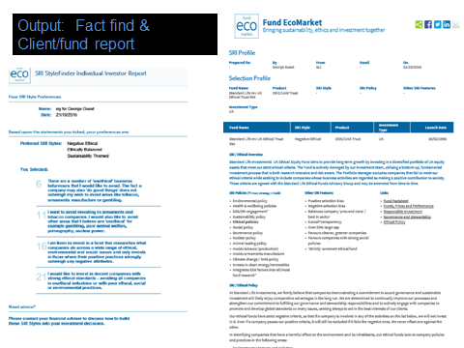
An adviser’s view...
“… I think that your site is the missing link for many IFAs who are nervous/anxious about raising ethical investing with their clients.
It gives them a process and an audit trail – and I suspect many of those advisers who don’t raise ethical investing with their clients don’t raise the issue because they have no process in place if the client was to say that they did want to invest ethically.
This is what happened to me, and it was only because I wanted to offer ethical investing to my clients that I discovered your site through my own research.”

Slide 16
Fund EcoMarket overview
Designed to help open up ‘regular investor’ retail ethical / SRI opportunities by being:
Ethical/SRI information only
Whole of (retail) market
Reliable & comprehensive
Focused on key areas / challenges
Advice process driven
Open to all, free to use
Independent
Unique
Other benefits
Helps build reputation & trust
Variety of uses eg research, advice & training
Compliments existing tools

Slide 17
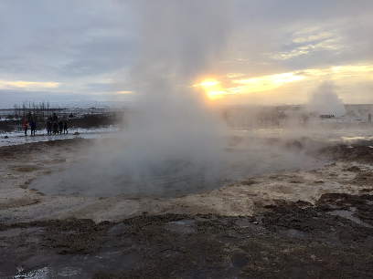
What to look out for in 2017
Five ‘i’ s
Intentions
(of fund/ fund manager)
Impact
(of strategy)
Integration
(of ESG factors ... aims & credibility vary)
Insurers
(can strategies remain so different?)
Interconnectivity
(investment & lifestyle)

Slide 18
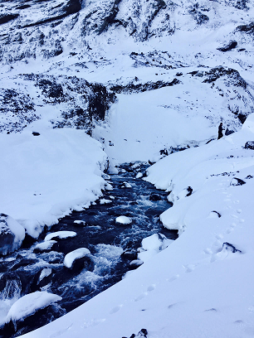
Next steps – bringing SRI into your business:
How can this area enhance your clients’ experience?
eg more client-centric advice, reflect different values, aims and interests (charities, parents)
How can this area benefit your business?
Younger clients, new recruits, paraplanners, review changing opinions, reputation, trust ... Adviser ISO 22222
What changes do you need to make for this to be a success for you?
Initial & supplementary fact finding, research, reporting
Does 1% sound right to you?

Slide 19
Thank you... attendees & partners Any questions?
Contact:
E: Julia@sriServices.co.uk
M: 07702 563702
www.sriServices.co.uk
www.FundEcoMarket.co.uk
Twitter: @JuliaDreblow

